Slide 1


Software Engineering II Data-driven Software Engineering -2
Lecturer: Shaowei Wang
Email: shaowei@cs.umanitoba.ca

Slide 2
Administrative item
Sprint 4's deadline is postponed to Dec 1st (Friday)
Final project deliverable is due on Dec 15th
Final exam
Schedule: Dec 13, 6 pm. https://umanitoba.ca/registrar/final-exams/final-exam-schedule
Scope: Lecture 1 - 12 (including fuzz testing, excluding data-driven SE).
Question type: multi-choice + problem-solving.
Examination format: In-person. You will be able to download a digital copy of the test (word file) from UMlearn and submit it to UMLearn.
Guideline: The exam is open book. You are allowed to access class notes, textbooks, and slides. However, no search online and the use of generative AI (e.g., ChatGPT) is not allowed.

Slide 3
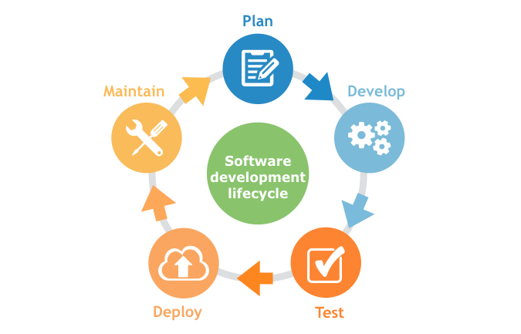

What to mine?
Mobile apps marketplace
……
Source Code
Issue Report
Question Answering Pairs: Stack Overflow
Traces/Logs
Pull Requests

Slide 4
Applications
Leveraging source code
Code recommendation
Code completion
…

Slide 5

What to mine?
Mobile apps marketplace
……
Source Code
Issue Report
Question Answering Pairs: Stack Overflow
Traces/Logs
Pull Requests

Slide 6
Artifact: Issue Reports
People report bugs and feature requests that they encounter in the field
Information possibly in issue reports:
Description of the issue
Steps to reproduce the issue
Severity level (priority?)
Parts of the system affected by the issue
Failure traces

Slide 7
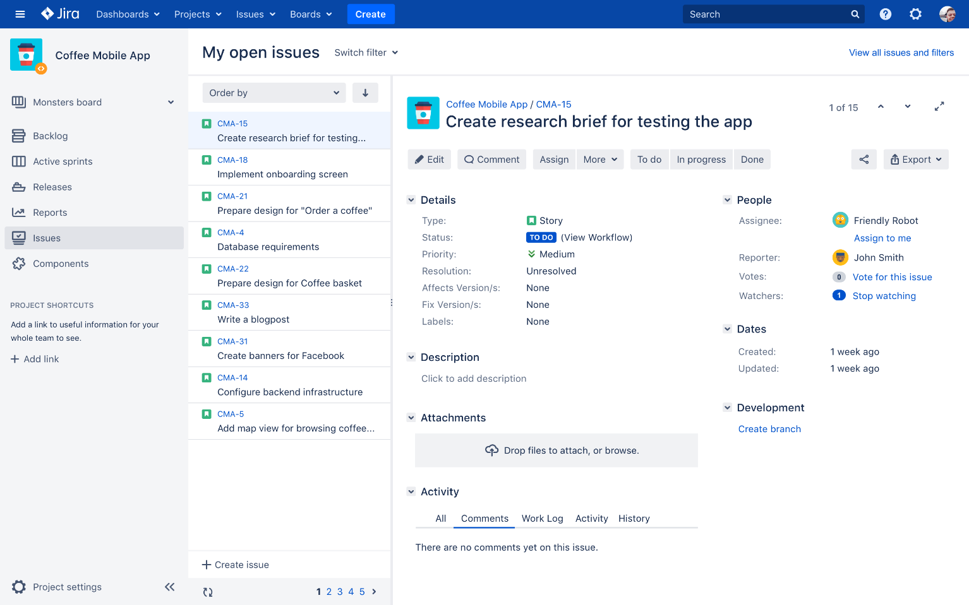
Artifact: Issue Reports
Various kinds of issue repositories
GitHub
Jira
Bugzilla
Etc.

Slide 8
Applications
Bug localization – given a bug report, identify the bugs in the source code.
Notes:
Bug localization is different from fault localization, in which we need running the test cases, and get a matrix of execution trace for each test case.

Slide 9

Bug localization: Introduction
Program is often large with thousands of files.
Given a bug report, how to locate files responsible for the bug?
A (semi) automated solution is needed.

Slide 10
Bug Localization: Technique
Model the similarity of bug reports and files/methods
Model the bug proneness of files
Number of bugs in a file (based on its history)
Model the similarity of previous bug reports
Wang S, Lo D. Version history, similar report, and structure: Putting them together for improved bug localization. In Proceedings of the 22nd International Conference on Program Comprehension 2014 Jun 2 (pp. 53-63).

Slide 11
Model the similarity of bug reports and files
Information retrieval techniques to calculate the similarity between reports and files
Vector space model – tfidf weighting

Slide 12
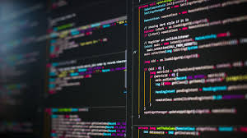
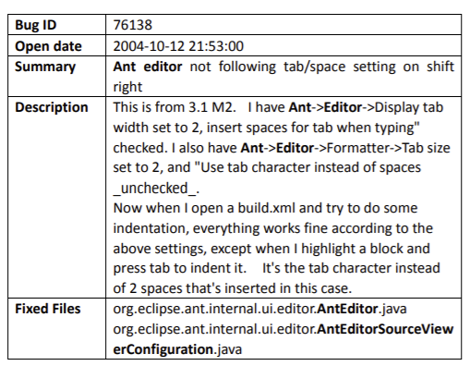
Pre-processing code
Text pre-processing
Vector_f1 [0.2,0.4, 0.6,…]
Vector_f2 [0.2,0.4, 0.6,…]
Vector_q [1,0.4, 0.2,…]
Vector_f2 [0.2,0.4, 0.6,…]

Slide 13
Pre-processing code
Text pre-processing
similarity
Vector_f1 [0.2,0.4, 0.6,…]
Vector_f2 [0.2,0.4, 0.6,…]
Vector_q [1,0.4, 0.2,…]
Vector_f2 [0.2,0.4, 0.6,…]

Slide 14
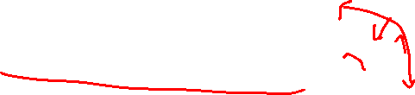
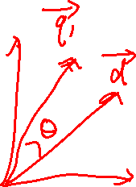
VSM: Retrieval
Represent documents and queries as vectors
Compute the similarity between the vectors
Cosine similarity is normally used:
Return top-k most similar documents
qi is the tf-idf weight of term i in the query
di is the tf-idf weight of term i in the document

Slide 15
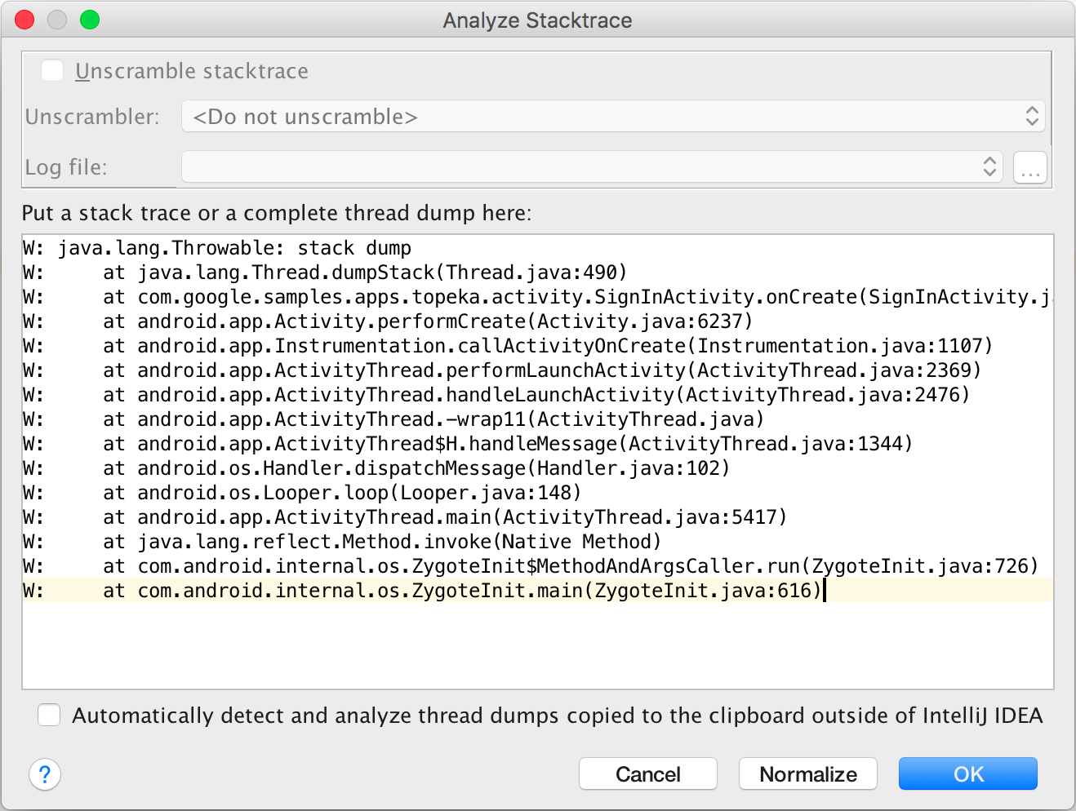
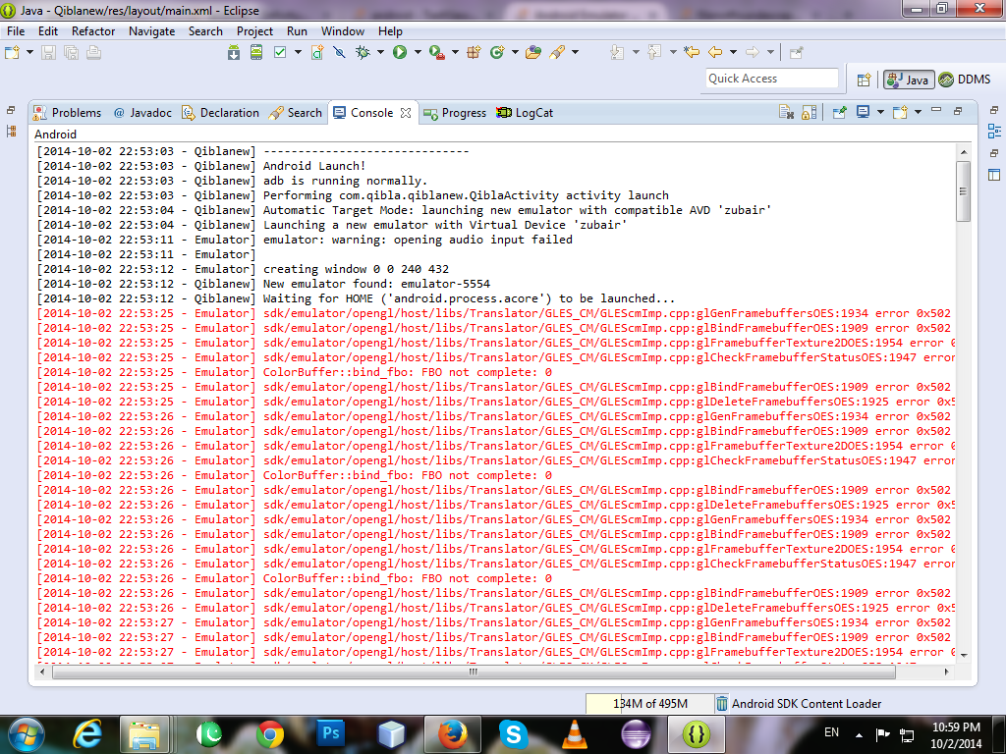
Weighting on different components
Stack trace
log

Slide 16
Model the similarity of bug reports and files
Information retrieval techniques to calculate the similarity between reports and files
Frequency based
Word counts
Term frequency – inverse document frequency weighting
Machine learning model-based
Word2vector
Doc2vector
BERT

Slide 17
Bug Localization: Technique
Model the similarity of bug reports and files/methods
Model the bug proneness of files
Number of bugs in a file (based on its history)
Model the similarity of previous bug reports

Slide 18
Model the bug proneness of files
Observation: a file that occurs a bug recently is more likely to happen bugs again.
Similar bugs usually happen in burst and not in isolation.
Predicting Faults from Cached History, by Kim et al.
Notes:
This approach is also applied to test case selection/prioritizaiton

Slide 19
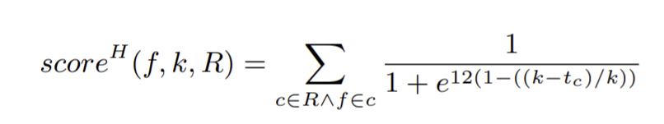

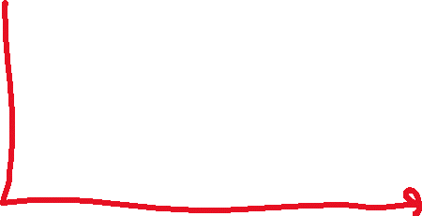

Capture frequency and time of a file being committed
Time window
Target file
Commits in k days
number of days that has elapsed between a commit c and the input bug report.

Slide 20
Bug Localization: Technique
Model the similarity of bug reports and files/methods
Model the bug proneness of files
Number of bugs in a file (based on its history)
Model the similarity of previous bug reports

Slide 21
Model the similarity of previous bug reports
Observation: similar bugs are likely to happen in similar files
Check out bug report before submitting a new bug report, to avoid duplicate.

Slide 22
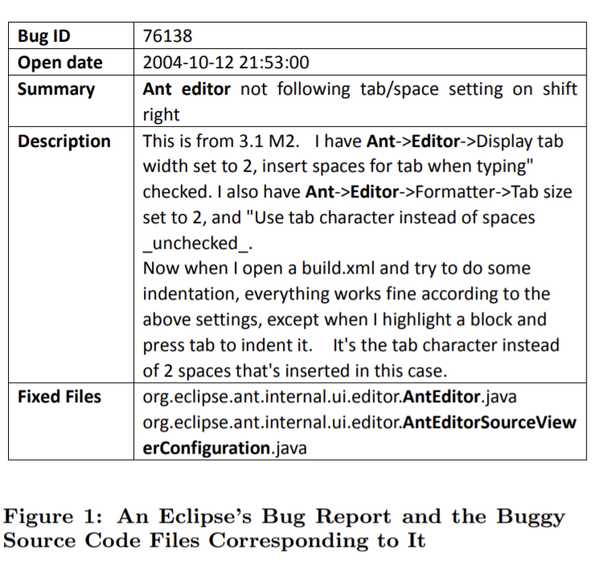
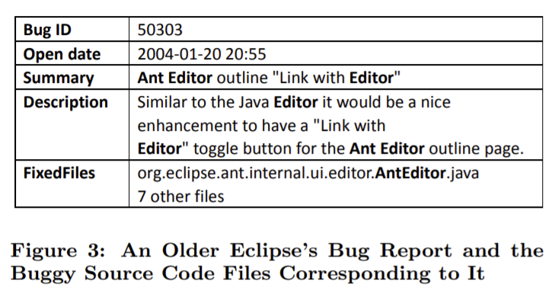



Slide 23
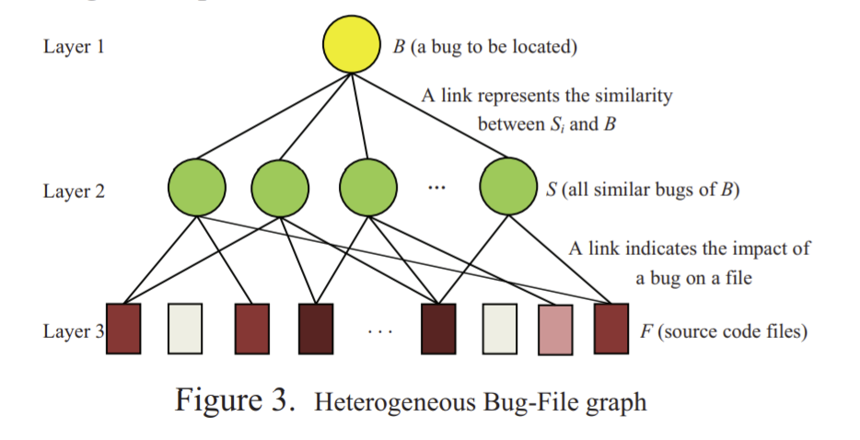
Model the similarity of previous bug reports
Notes:
If a file is linked with more similar bug reports, the file are more likely to associated with the target bug report.

Slide 24
Hybrid technique
Model the similarity of bug reports and files/methods
Model the bug proneness of files
Model the similarity of previous bug reports

Slide 25
Other applications
Recommend developer to fix bugs
Predict the severity of bugs
Etc.

Slide 26
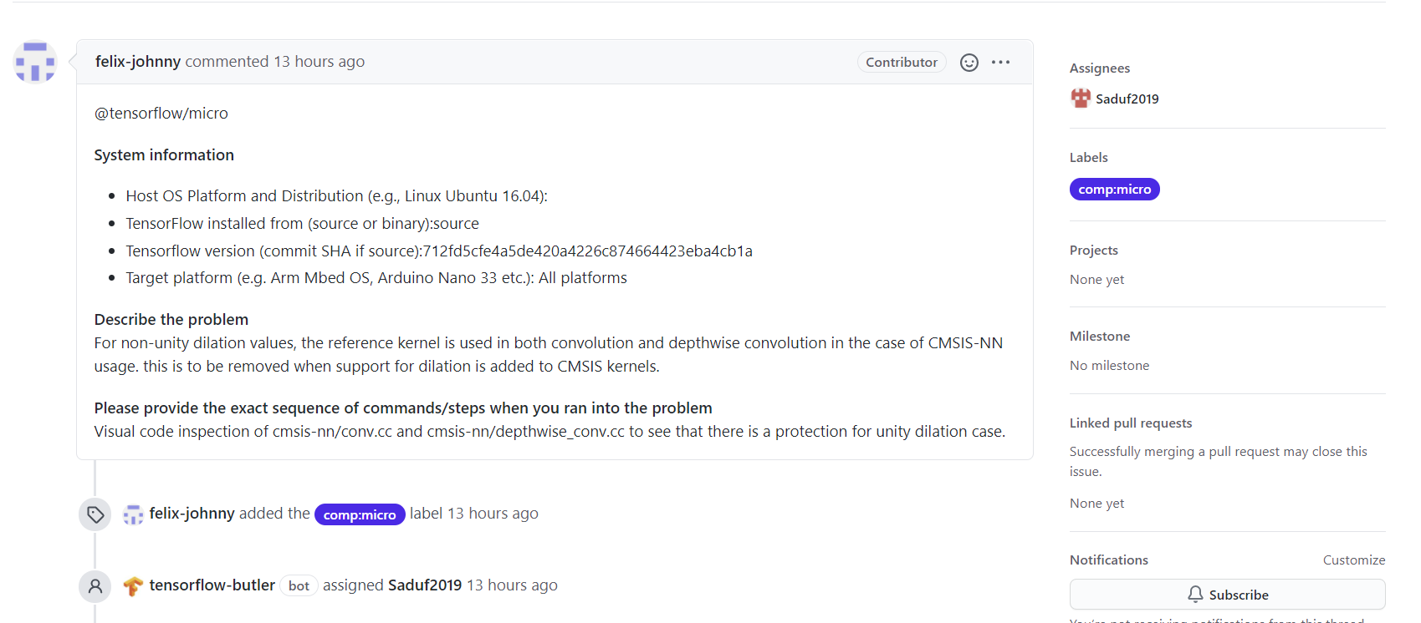




Recommend developer to fix bugs: Introduction

Slide 27
Recommend developer to fix bugs: Technique
Leverage activities profile
Ownership, review, resolve in the bug track system
Leverage expertise
Topic model

Slide 28
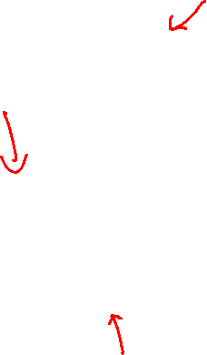
Find similar bug reports
The fixer of the similar bugs
Reviewer of the similar bugs

Slide 29
Recommend developer to fix bugs: Technique
Leverage activities profile
Review, commit, ownership, resolve in the bug track system
Leverage expertise
Topic model

Slide 30
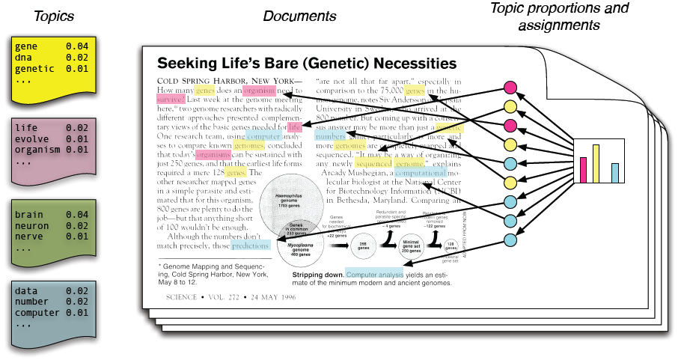
Topic Modeling: Black-Box View
Model a document as a probability distribution of topics
A topic is a probability distribution of words
Most simple and common :LDA
Notes:
Dimensionality reduction: words -> topics
Benefit: Able to link a document and a query
Do not have share any words
Share related words of the same topics

Slide 31
Usage of Topic Modeling
Dimensionality reduction: words -> topics
Help with data exploration.
Able to link a document and a query
Do not have share any words
Share related words of the same topics

Slide 32
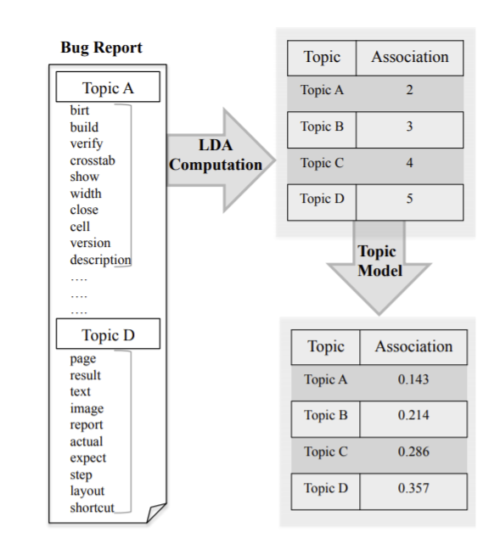

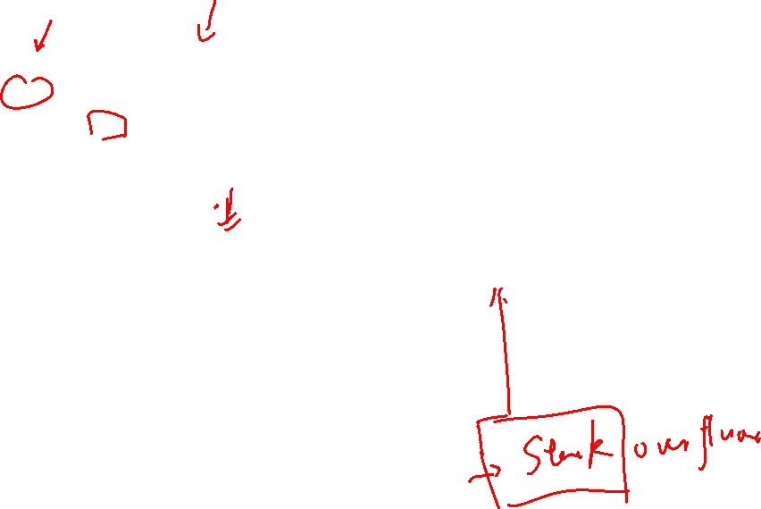
comments
Fixed bugs
Developer
Tags
Developed project/component/files

Slide 33
Leverage expertise
Model expertise of developers using topic model
VD_comment[t1,t2,… tk], VD_development[t1,t2,… tk]
Model the required expertise of a bug report using topic model
VB[t1,t2,… tk]
Match developers and bug reports based on their expertise
Topic matching
Calculate similarity

Slide 34

What to mine?
Mobile apps marketplace
……
Source Code
Issue Report
Question Answering Pairs: Stack Overflow
Traces/Logs
Pull Requests

Slide 35
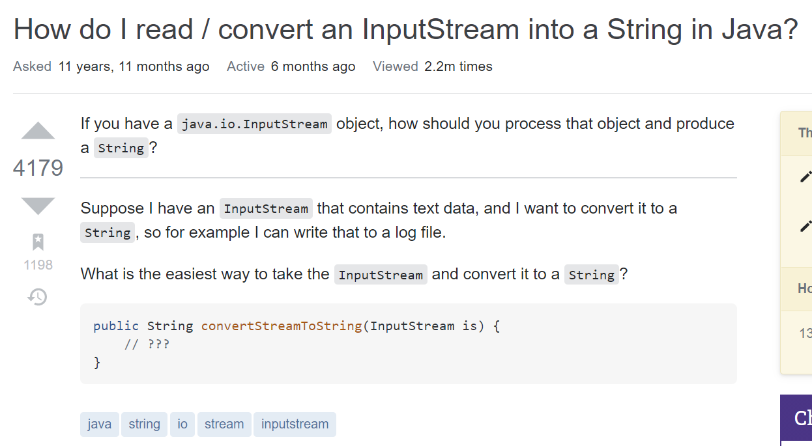
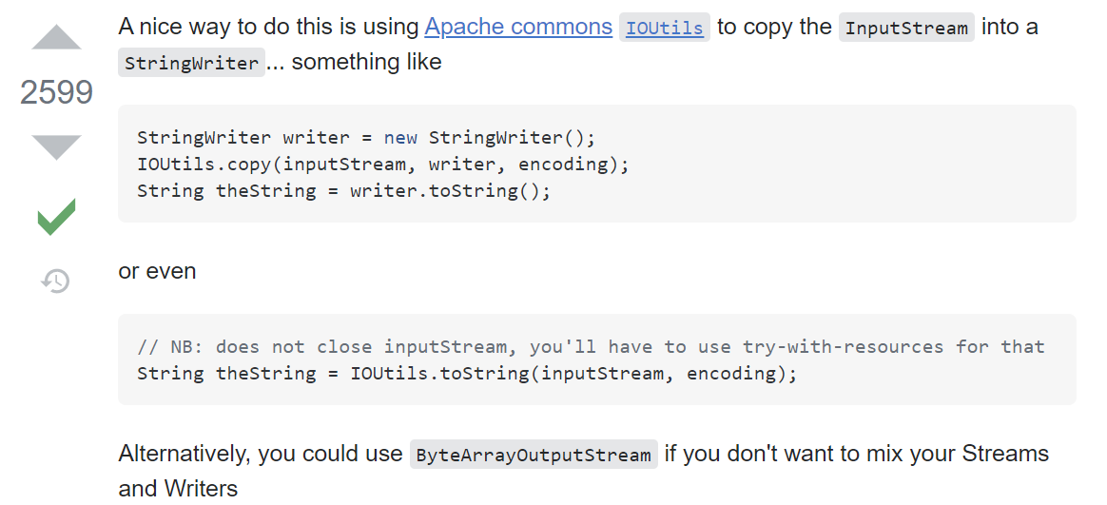
Various types of data on Stack Overflow
Text description
Tags
Code snippets
votes

Slide 36
Mining & leveraging big SE crowd knowledge data
Mining big SE crowd knowledge data
https://meta.stackexchange.com/questions/134495/academic-papers-using-stack-exchange-data

Slide 37
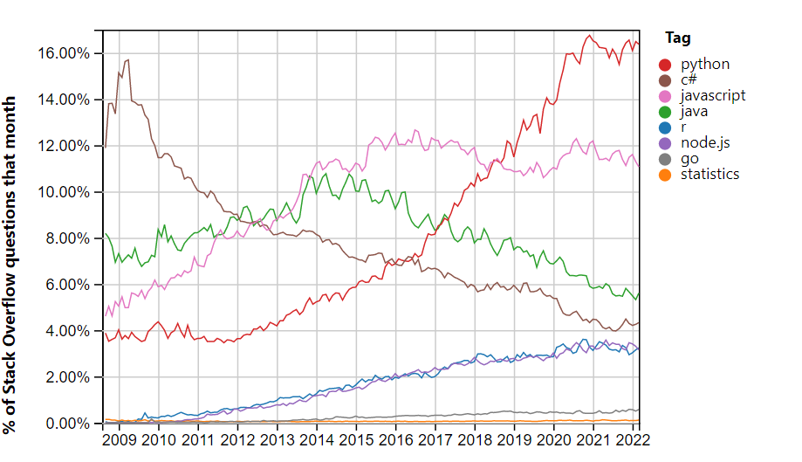

Slide 38
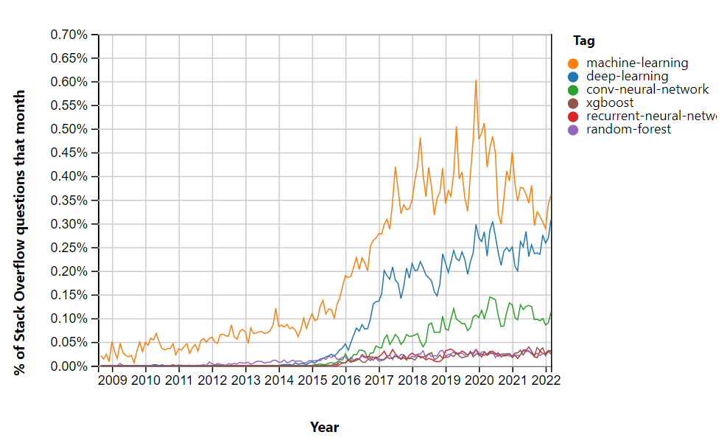

Slide 39
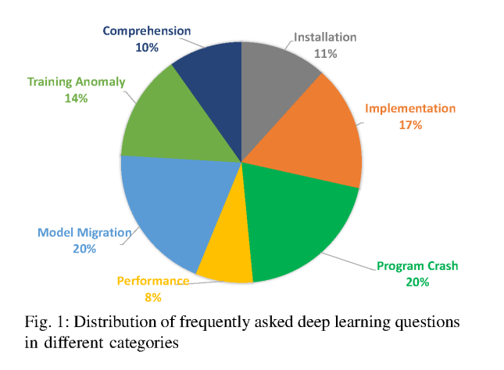
Zhang T, Gao C, Ma L, Lyu M, Kim M. An empirical study of common challenges in developing deep learning applications. In2019 IEEE 30th International Symposium on Software Reliability Engineering (ISSRE) 2019 Oct 28 (pp. 104-115). IEEE.

Slide 40
How do developers utilize source code from Stack Overflow?
Empirical Software Engineering Journal(EMSE) 2018
Yuhao Wu et al.

Slide 41
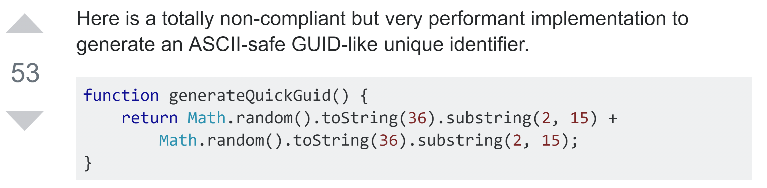
Developers reuse source code from S.O. posts
An answer on Stack Overflow
function generateID() {
return "avalon" +
Math.random().toString(36).substring(2, 15) +
Math.random().toString(36).substring(2, 15)
}
Source code in a GitHub project
Notes:
https://stackoverflow.com/questions/105034/create-guid-uuid-in-javascript/13403498#13403498
https://github.com/yinuoba/avalon/blob/master/avalon.js#L343

Slide 42
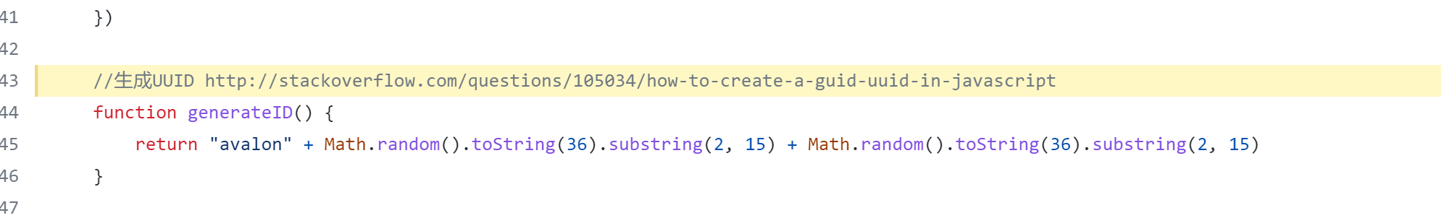
How we can know a code snippet was reused from SO

Slide 43



Structure of this study
Part I: Exploratory Study
How do developers reuse source code?
Part II: Survey
How do you think S.O. can be improved?
Responses
Notes:
https://www.supportdriven.com/github-logo/

Slide 44

Part I: Exploratory study
searchcode.com
4,878 source files
“stack overflow”
Filter
RQ1: modification frequency and reason
289 files
Analyze code reuse
RQ2: origin of code reuse
Notes:
https://www.flaticon.com/free-icon/search_722080#term=search%20icon&page=1&position=45

Slide 45
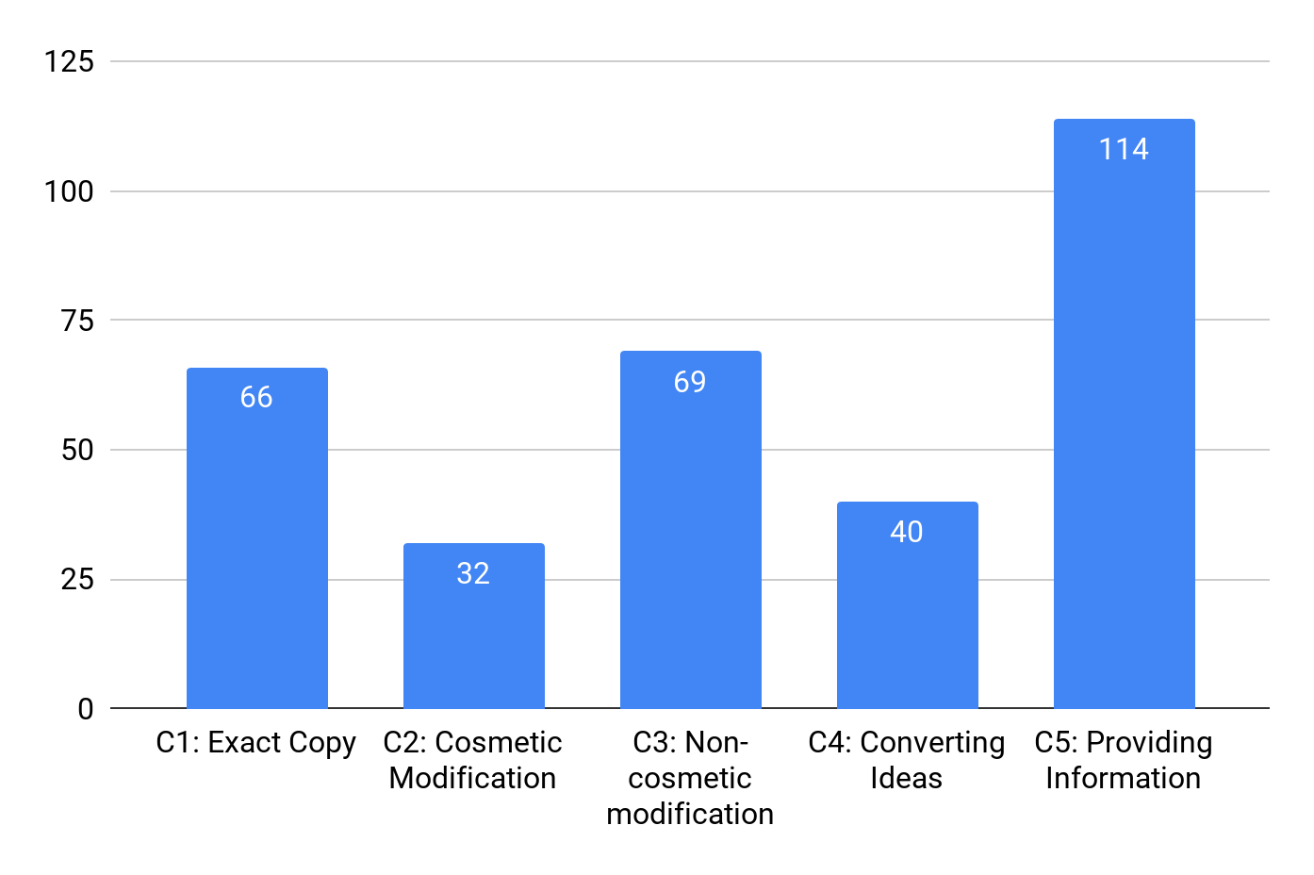
Only 21% of the code are copied exactly
32% of the reused source code snippets requires additional modification (C2+C3)
35%
22%
Reimplement based on the idea presented in the answers
21%
13%
10%

Slide 46
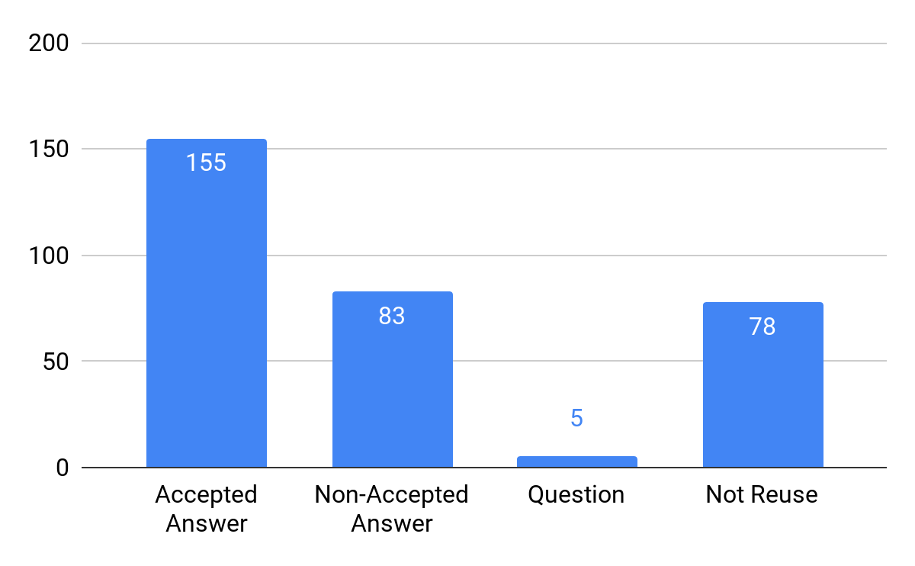
26% of the source code was reused from non-accepted answers
Developers adopt answers based on different needs: simplicity, correctness, efficiency, etc.
An advanced tagging system might be helpful
43%
26%
30%
1%

Slide 47
Part II: Large-scale survey on 400+ participants
Survey Questions
Experience
Type of project participated
...
Demography (7)
Difficulties in reusing source code
Opinions on OSS licenses
...
Barriers (10)
Suggestions (2)
Usefulness of proposed advanced tagging system
Any other suggestions
...

Slide 48
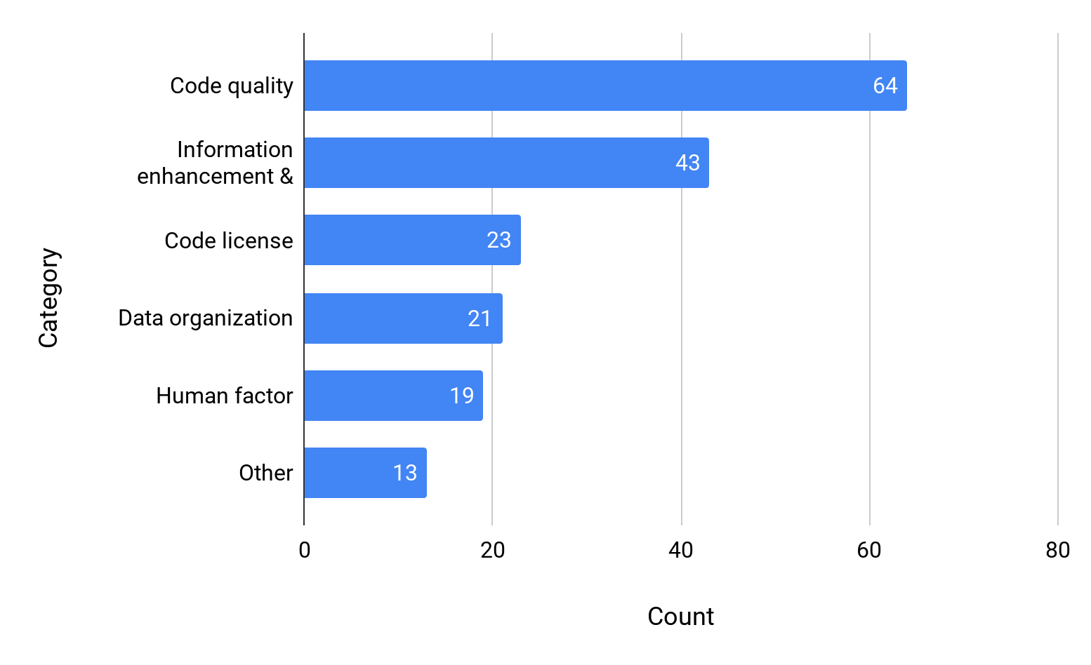
Most suggestions are on code quality
35%
24%
13%
12%
10%
7%

Slide 49
Suggestions: improving code quality
(35% of all categories)
Integrated validator
(42.2%)
Outdated code
(29.7%)
Answer quality
(17.2%)
Code review
(10.9%)
“An inbuilt environment for as many languages/ environments as possible.”
“Make date important in marking outdated code, and deprecate those snippets via the community”
“Better support for answers that are good, but out of date.”
“In-browser code review and commenting similar to that provided by commercial code review tools.”

Slide 50
Understanding the challenges and problems that developers face
Beyer, S., Macho, C., Di Penta, M. and Pinzger, M., 2020. What kind of questions do developers ask on Stack Overflow? A comparison of automated approaches to classify posts into question categories. Empirical Software Engineering, 25(3), pp.2258-2301.
Yang, X.L., Lo, D., Xia, X., Wan, Z.Y. and Sun, J.L., 2016. What security questions do developers ask? a large-scale study of stack overflow posts. Journal of Computer Science and Technology, 31(5), pp.910-924.
Ahmed, S. and Bagherzadeh, M., 2018, October. What do concurrency developers ask about? a large-scale study using stack overflow. In Proceedings of the 12th ACM/IEEE International Symposium on Empirical Software Engineering and Measurement (pp. 1-10).
Islam, M.J., Nguyen, H.A., Pan, R. and Rajan, H., 2019. What do developers ask about ml libraries? a large-scale study using stack overflow. arXiv preprint arXiv:1906.11940.
Barua, A., Thomas, S.W. and Hassan, A.E., 2014. What are developers talking about? an analysis of topics and trends in stack overflow. Empirical Software Engineering, 19(3), pp.619-654.

Slide 51
Mining & leveraging big SE crowd knowledge data
Mining big SE crowd knowledge data
Leveraging big SE crowd knowledge data
https://meta.stackexchange.com/questions/134495/academic-papers-using-stack-exchange-data

Slide 52
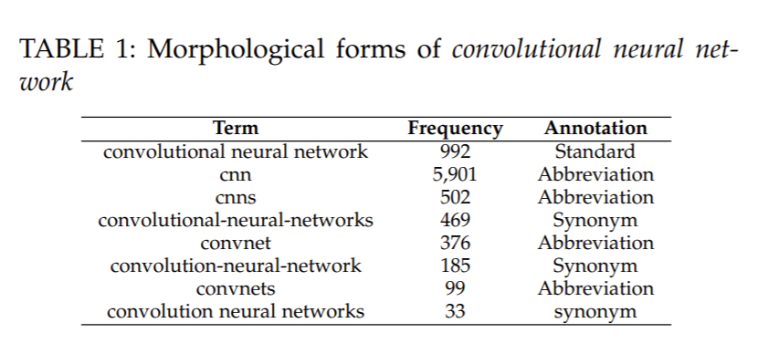

We need a thesaurus to contain software-specific terms and commonly-used morphological forms
We have different morphological forms (abbreviations, synonyms and misspellings)

Slide 53
We need a thesaurus to contain software-specific terms and commonly-used morphological forms
We have existing general thesaurus for morphological forms
Wordnet (https://wordnet.princeton.edu/)
Same word in SE and in other domain may have different meaning
Apple -> cell phone; Apple -> fruit;
Domain specific knowledge is important!

Slide 54
Why we care about this?
Identify various morphological forms of the same concept may also mitigate data sparsity problems when applying NLP techniques for various applications -> reduce the vocabulary size
Information retrieval
Data mining

Slide 55
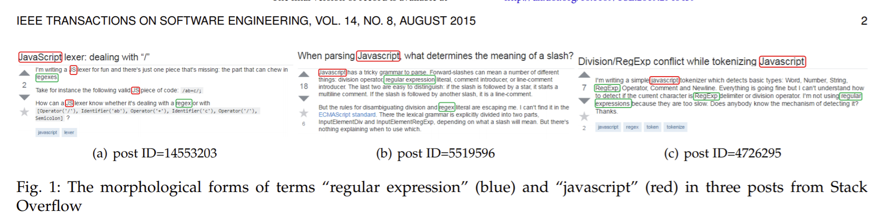
Leverage Stack Overflow to train a model to identify the relational regularities
Underling intuition is that words with similar meaning would appear in the similar context.
-> E.g., Javascript, JS, and JavaScript are used in the similar context
SEthesaurus: WordNet in Software Engineering IEEE TRANSACTIONS ON SOFTWARE ENGINEERING (TSE) 2015. Xiang Chen, Chunyang Chen, Dun Zhang, and Zhenchang Xing

Slide 56
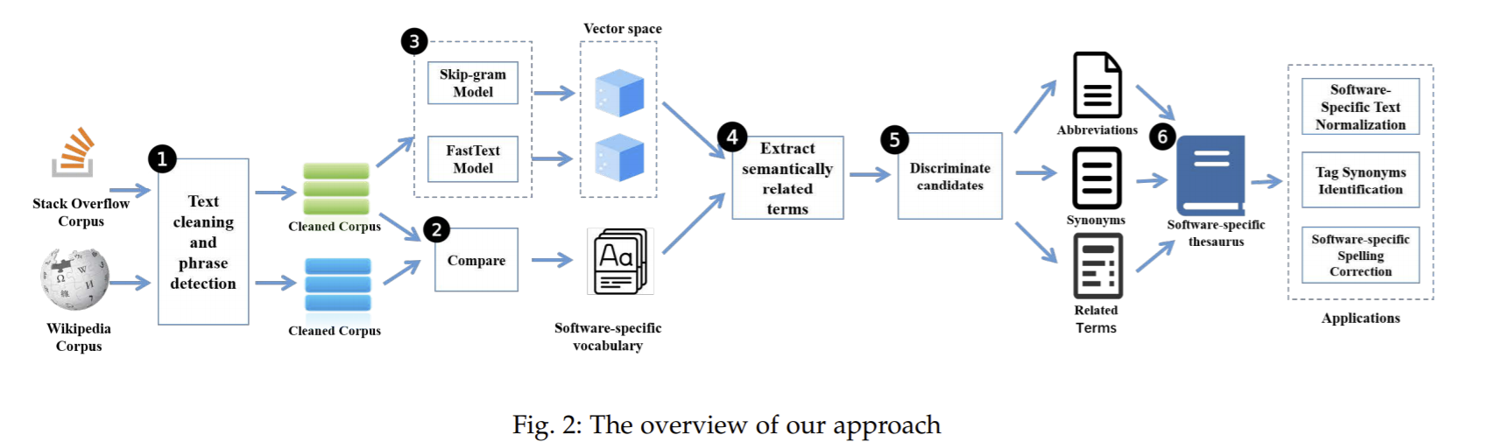
Overview of the approach
Notes:
Wiki is domain-agnostic

Slide 57

Data collection
Software specific corpus
->Stack Overflow
->15,930,617 questions and 24,676,333 answers
Domain agnostic corpus
->Wikipedia
->8,556,773 articles

Slide 58
Overview of the approach
Notes:
Wiki is domain-agnostic

Slide 59
Pre-processing
Text cleaning
remove HTML tags
remove long code snippets but keep short code snippets (e.g., method name)
remove all references
Tokenization
software-specific tokenizer, which keeps integrity of code-like tokens (e.g., numpy.ndarray.argmin())
Phrase Detection
Up to four grams
e.g., operating system (OS), breadth first search (BFS)
“Distributed representations of words and phrases and their compositionality” by Mikolov et al. Proceedings of Advances in neural information processing systems, 2013

Slide 60
Overview of the approach
Notes:
Wiki is domain-agnostic

Slide 61
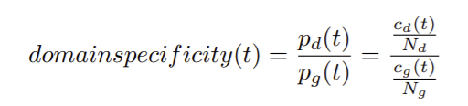
Building software-specific vocabulary
Identify software-specific terms by contrasting the frequency of a term in the software-specific corpus compared with its frequency in the general corpus
Pd(t) and Pg(t) are the probability of t in domain specific corpus and general corpus
Threshold: 10

Slide 62
Overview of the approach
Notes:
Wiki is domain-agnostic

Slide 63
How embedding works?
Vector Embedding: Word Similarity
A simple assumption:
Similar words occur in similar contexts. They are exchangable.
e.g., we can remove/discard the word from the string.
This definition supports unsupervised learning: cluster or embed words according to their contexts.
Idea: representing a word by means of its neighbors

Slide 64
Learning term semantics
Learn work embedding
Two approaches
Continuous skip-gram model
FastText model
Using the cleaned SO data

Slide 65
Overview of the approach
Notes:
Wiki is domain-agnostic

Slide 66
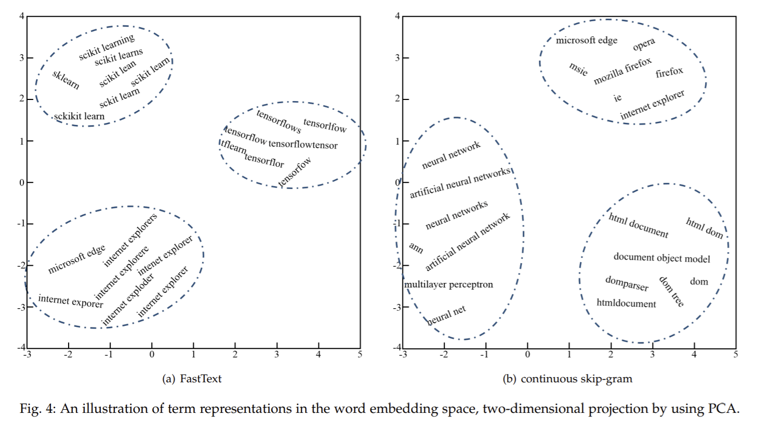
Extracting semantically related terms
Use cosine similarity to calculate the similarity of two words.
Take top 40 words from Continuous skip-gram model and FastText model, and union them as the final candidates

Slide 67

Overview of the approach
Notes:
Wiki is domain-agnostic

Slide 68
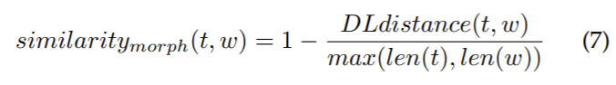
Discriminating synonyms
One observation: morphological-synonyms among semantically related terms can be usually transformed from one term to another by performing a small number of string edits ([tf idf, tfidf], [windows-service, windowsservices], [angular, angularjs])
Use Levenshtein distance (i.e., Damerau-Levenshtein (DL)) to measure the string edit distance
Measure single-character edits (such as insertions, deletions, substitutions, and transpositions)
Threshold 1/3

Slide 69
Discriminating abbreviations
Determine if a word w as an abbreviation of the term t using following heuristics-based lexical rules:
The characters of the term w must be in the same order as they appear in the term t, such as (pypi, python pacage index), (amq, activemq);
The length of the term w must be shorter than that of the term t;
If there are digits in the term w, there must be the same digits in the term t, e.g., vs2010 is regarded as an abbreviation of visual studio 2010, but vs is not regarded as an abbreviation of visual studio 2010;
The term w should not be the abbreviation of only some words in a multi-word phrase. For example, cmd is regarded as the abbreviation of command, but not as the abbreviation of command line

Slide 70
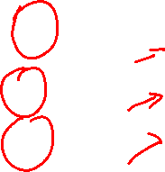
Overview of the approach
Notes:
Wiki is domain-agnostic

Slide 71
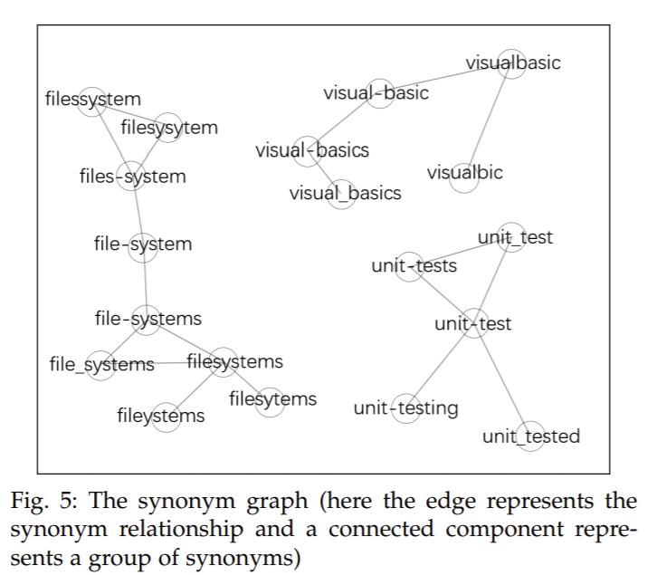

Slide 72
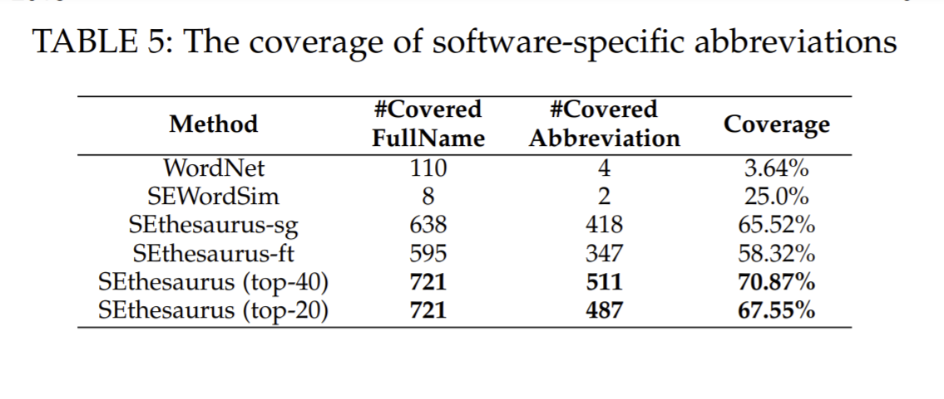
Coverage

